Slide 1
GRA-UML
Interim Progress Report
June 2014

Slide 2
Status
RFP has been issued
Submission team is developing specification
Basic approach and sample models have been produced
Details available on GIT site
https://github.com/GRA-UML/specification.git
Participation and comments welcome

Slide 3
Goals
Provisioning a complete and conformant GRA service specification (SSP)
Providing flexibility for the many possible variations in service technologies, standards and styles
Allowing use of “normal” UML wherever possible
Allow use of SoaML patterns without requiring SoaML stereotypes.

Slide 4
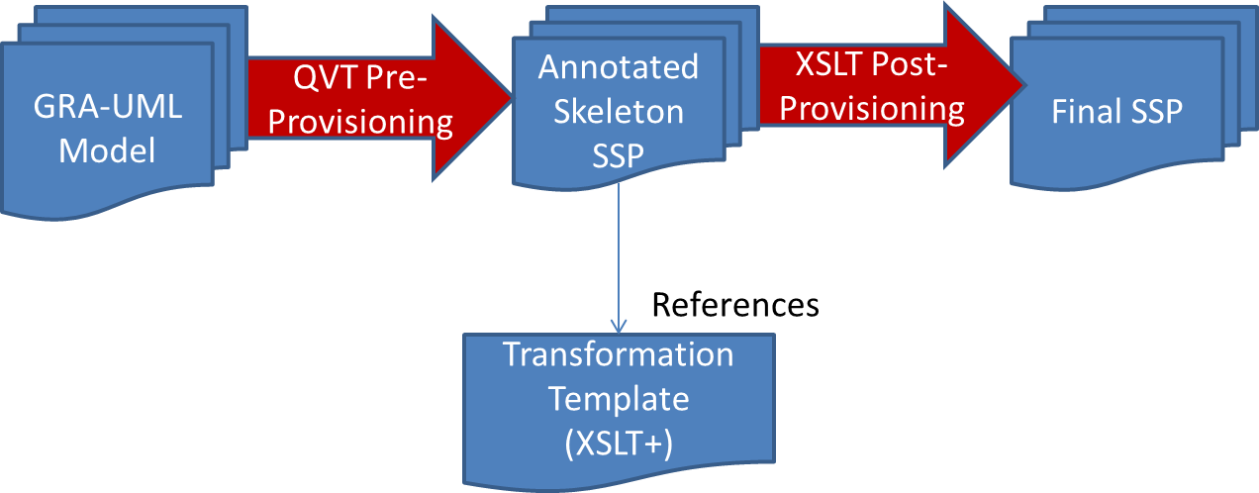
Approach: 2 Phase Provisioning

Slide 5
The UML PIM

Slide 6
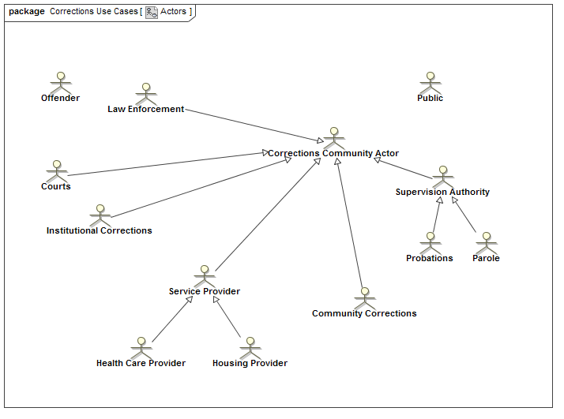
Actors

Slide 7
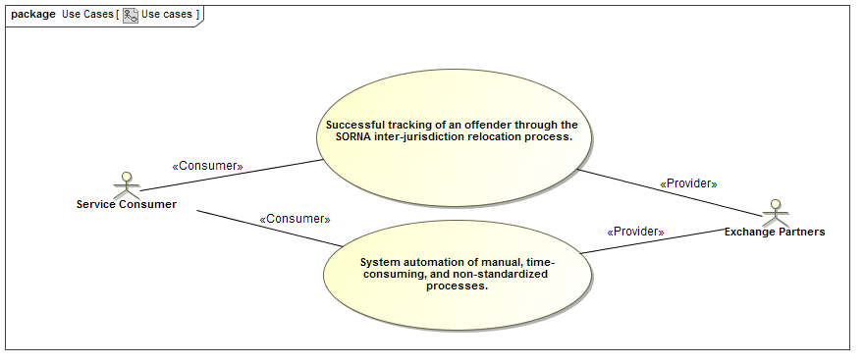
Use cases
Real World Effect

Slide 8
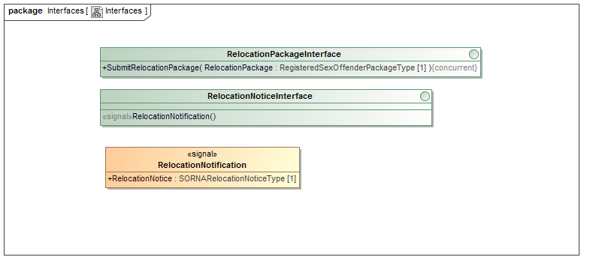
Interfaces
Become WSDL port types and “Actions”

Slide 9
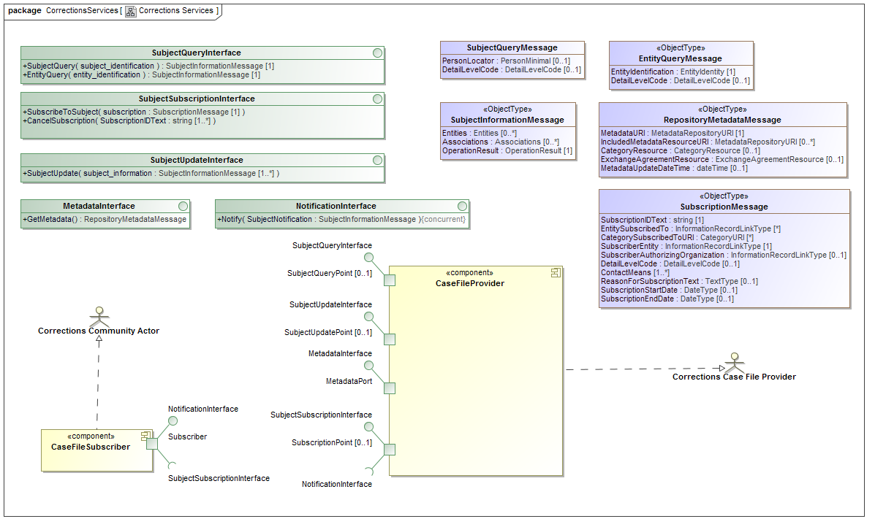
Ports on Components
Each component is a service, ports relate to WSDL ports

Slide 10

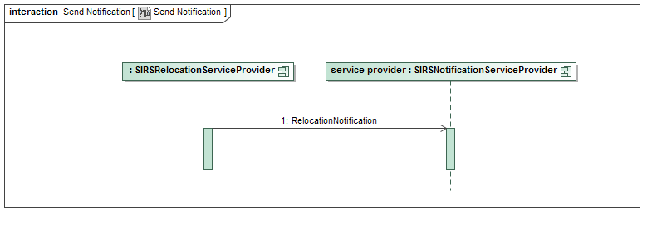
Communities and Interactions
Become Exchange Choreographies

Slide 11
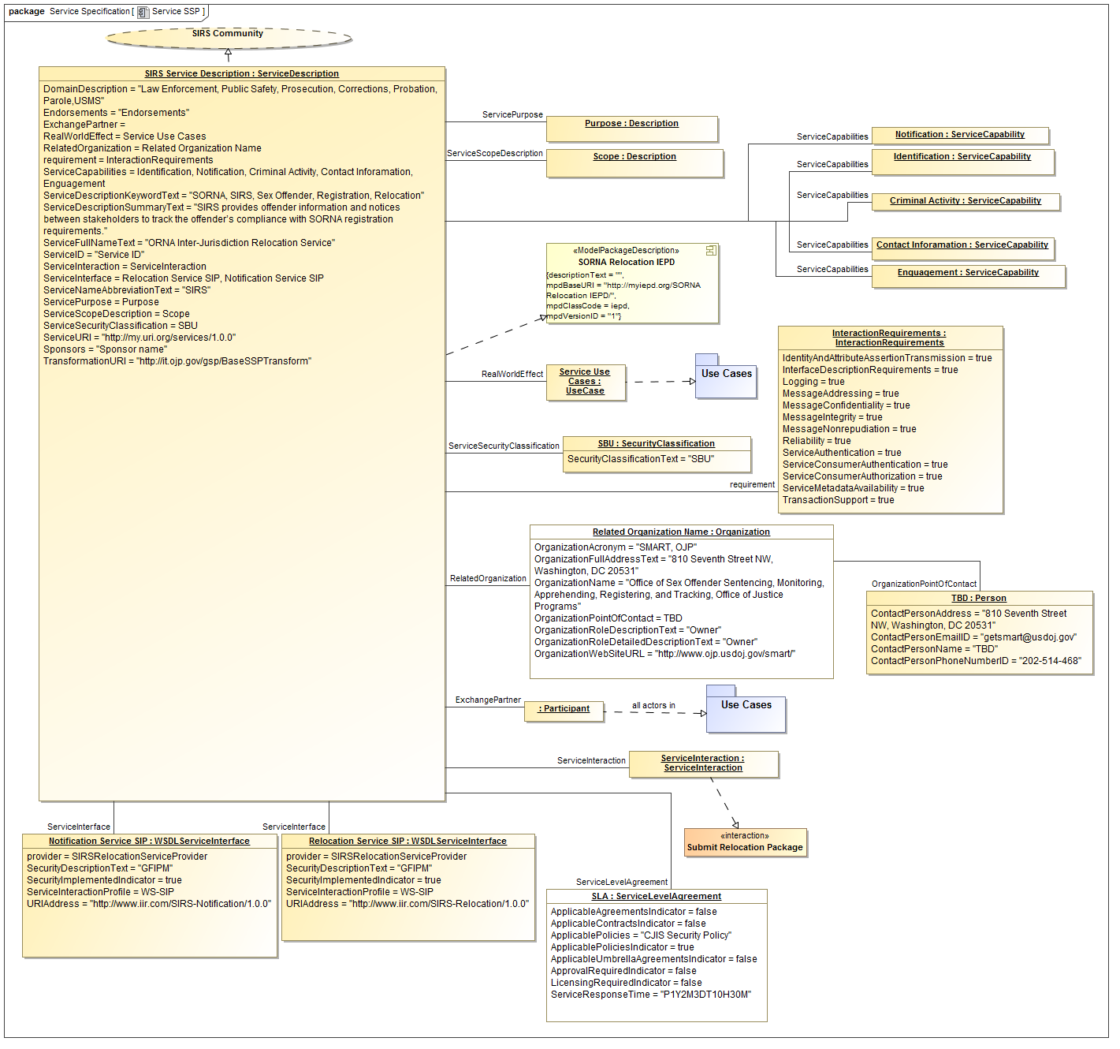
GRA SSP Specific Metadata
Populates output from “phase 1”

Slide 12
Expansion of metadata

Slide 13
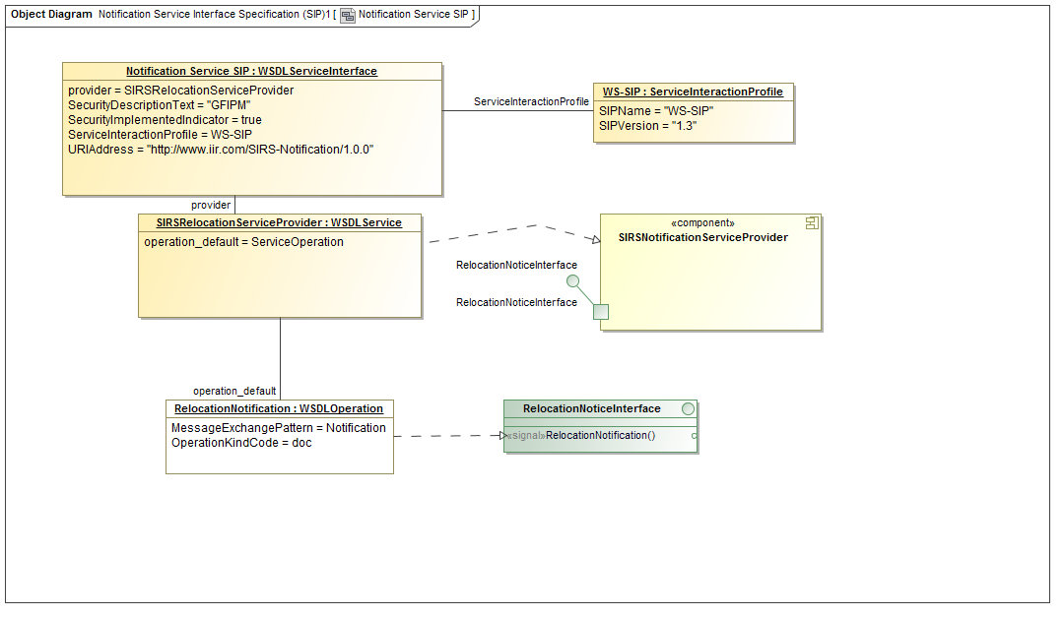
SIDD (Service Interface) Metadata

Slide 14
Phases
Metadata plus PIM information is output to skeleton SSP information
XSLT is then used to process these files to produce final SSP
Developers will be able to “tune” phase 2 for use of other styles and technologies

Slide 15
Metadata Model

Slide 16
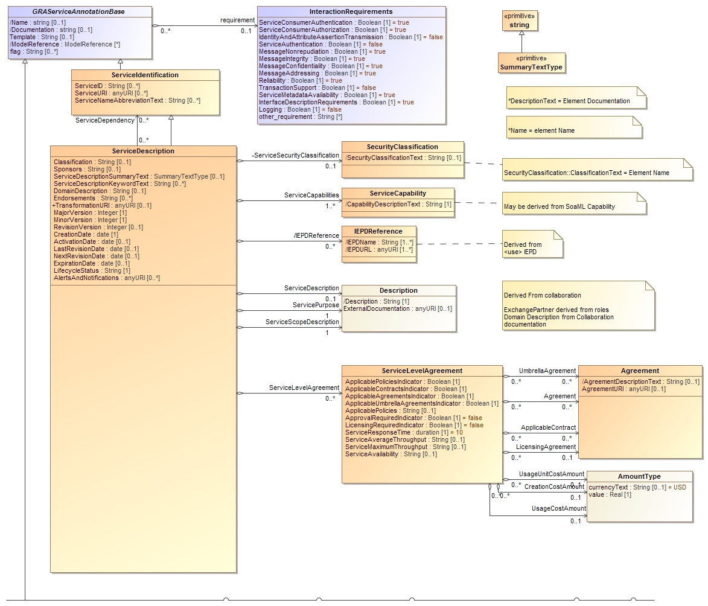

Slide 17
